Slide 2
PHP Include Files
The include (or require) statement
takes all the text/code/markup that exists in the specified file
copies it into the file that uses the include statement.
Including files is very useful
when you want to include the same PHP, HTML, or text on multiple pages of a website.

Slide 3
Index.php
<html>
<head>
<title> This is my first PhP page</title>
<?php include 'header.php';?>
</head>
<body>
<?php include 'login.php';?>
<?php include 'footer.php';?>
</body>
</html>

Slide 4
Header.php
<html>
<style>
div
{
width: 700px;
margin-left: auto;
margin-right: auto;
background-color: yellow;
border-radius:2px;
}
h1 {
text-align: center;
font-size: 5em;
}
</style>
<body>
<div> <h1>Online Examination </h1></div>
</body>
</html>

Slide 5
Login.php
<html>
<style>
div
{
height:auto;
width:auto;
border: 2px solid green;
align:center;
}
</style>
<body>
<div>
<span style="font-weight:bold">Enter Login Details!!!</span>
<form >
<br>
Name: <input type="text" name="name"><br><br>
Password: <input type="password" name="passwd">
<input type="submit" ><br><br>
</form>
</div>
</body></html>

Slide 6
Footer.html
<html>
<body>
<center>
<footer>
<p>Copyright &copy; 2012 Sergio Luján Mora</p>
<p><a href="mailto:sergio.lujan%20at%20ua.es">Contact</a></p>
</footer>
</center>
</div>
</body>
</html>

Slide 7
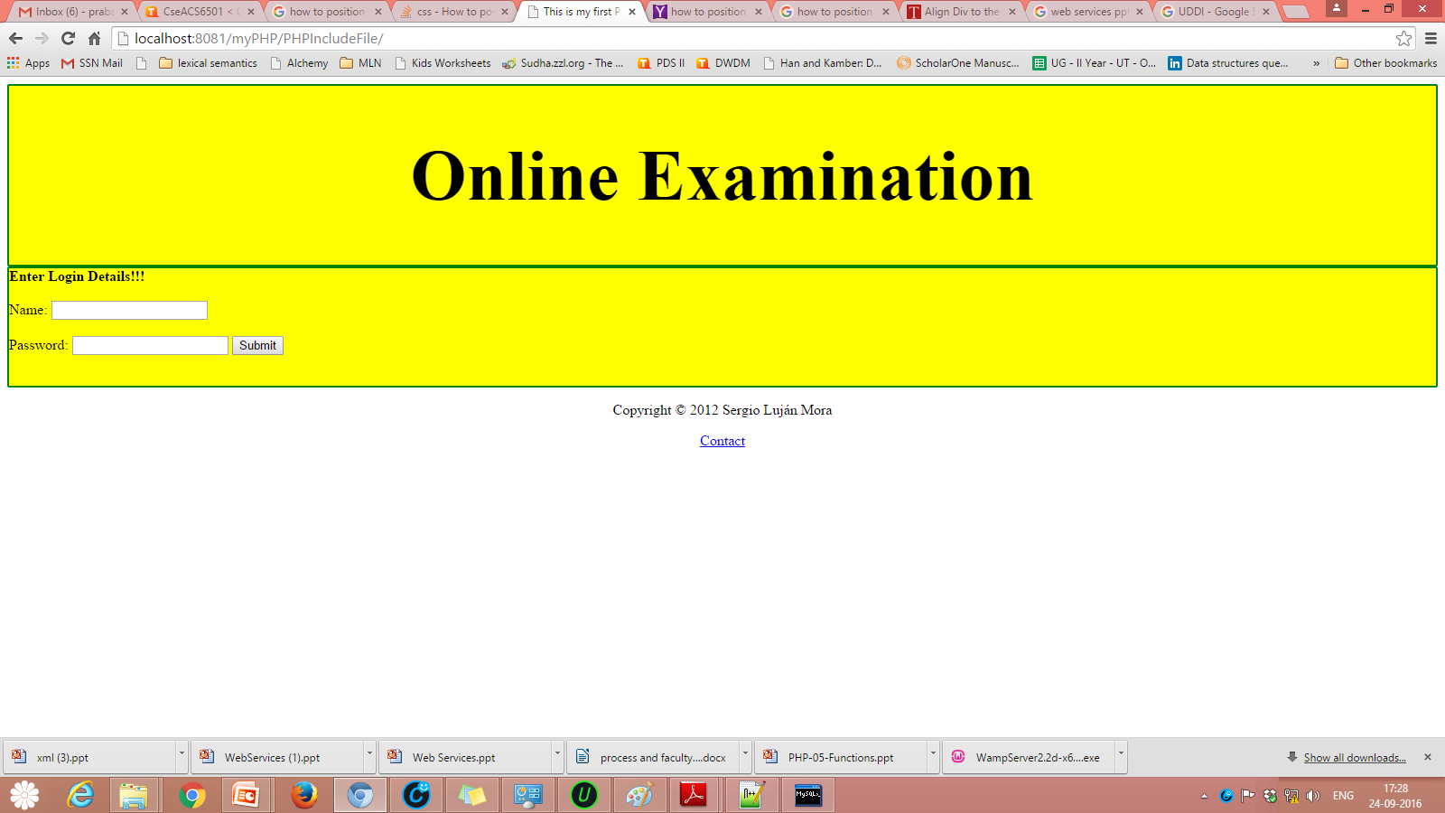
Output for PHP File Inclusion

